Slide 1
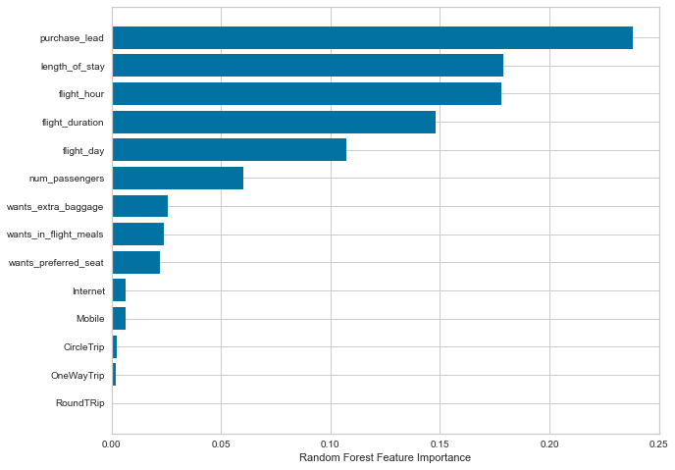
BA PREDICTIVE MODELLING RESULTS
66%
Recall rate
62%
Precision
Top features that can drive successful flight bookings
Chance of predicting true successful bookings
Will be predicted as actual completed bookings out of all successfully completed bookings.
Accuracy of the model predicting successful or incomplete bookings.
63%
Accuracy
This model requires more improvement. I suggest adding more customer-centric features into the model.

